Slide 1
Introduction to deep learning for LArTPCs
Andy Chappell
11/11/2022 LArSoft Workshop

Slide 2
Introduction
So far, we’ve looked predominantly at general deep learning concepts
Now we’ll look at some more specific architectures and application to LArTPCs
Introduction to semantic segmentation
Pandora’s vertex finding network in DUNE
ResNets

Slide 3
U-Nets for semantic segmentation
U-Net concept introduced in 2015 for biomedical image segmentation
The name comes from the conceptual structure of the network
ConvBlock TConvBlock .
Input
Input
Skip
Conv2D
Cx3x3
TConv2D
Cx3x3
cat
BatchNorm
BatchNorm
View
ConvBlock
ConvBlock
Sigmoid
ReLU
ReLU
MaxPool
x4
x4
DropOut
Conv2D
Cx3x3
DropOut
TConvBlock
We’ll briefly discuss BatchNorm and ReLU later
BatchNorm
ConvBlock
Recall: Pooling merges neighbouring pixels: MaxPool picks the largest pixel from a group DropOut randomly turns off weights during training to reduce over-fitting

Slide 4
U-Nets for semantic segmentation
Down-sampling and feature extraction is performed via a Convolutional Neural Network (CNN) in the left arm of the U
Result of each intermediate convolution block is retained for use in skip connections
ConvBlock TConvBlock .
Input
Input
Skip
Conv2D
Cx3x3
TConv2D
Cx3x3
cat
BatchNorm
BatchNorm
View
ConvBlock
ConvBlock
Sigmoid
ReLU
ReLU
MaxPool
x4
x4
DropOut
Conv2D
Cx3x3
DropOut
TConvBlock
BatchNorm
ConvBlock

Slide 5
What are skip connections?
The final output of a U-Net needs to be the same size as the original input.
Repeatedly down-sampling means we have to get back to high resolution from very low resolution
Skip connections provide a means to augment up-sampled images with higher-resolution activations from earlier network layers
ConvBlock TConvBlock .
Input
Input
Skip
Conv2D
Cx3x3
TConv2D
Cx3x3
cat
BatchNorm
BatchNorm
View
DS Layer 1
US Layer 4
ReLU
ReLU
DS Layer 2
US Layer 3
Conv2D
Cx3x3
BatchNorm
DS Layer 3
US Layer 2
DS Layer 4
US Layer 1
Bridge
Skip connection

Slide 6
U-Nets for semantic segmentation
Up-sampling and image augmentation is performed via transpose convolutions (discussed later) in the right arm of the U
Intermediate results from down-sampling are added to the up-sampled images via skip connections to “fill in the gaps” from up-sampling
ConvBlock TConvBlock .
Input
Input
Skip
Conv2D
Cx3x3
TConv2D
Cx3x3
cat
BatchNorm
BatchNorm
View
ConvBlock
ConvBlock
Sigmoid
ReLU
ReLU
MaxPool
x4
x4
DropOut
Conv2D
Cx3x3
Skip connections add images from down-sampling path to up-sampling path
DropOut
TConvBlock
BatchNorm
ConvBlock

Slide 7
U-Nets for semantic segmentation
The base of the U is known as the bridge
Performs additional feature extraction
Ensures matching tensor sizes between down-sampling and up-sampling arms
ConvBlock TConvBlock .
Input
Input
Skip
Conv2D
Cx3x3
TConv2D
Cx3x3
cat
BatchNorm
BatchNorm
View
ConvBlock
ConvBlock
Sigmoid
ReLU
ReLU
MaxPool
x4
x4
DropOut
Conv2D
Cx3x3
Skip connections add images from down-sampling path to up-sampling path
DropOut
TConvBlock
BatchNorm
ConvBlock

Slide 8
U-Nets for semantic segmentation
Key goal of the U structure is to classify every pixel from the input image
Track versus shower
Particle ID
…
ConvBlock TConvBlock .
Input
Input
Skip
Conv2D
Cx3x3
TConv2D
Cx3x3
cat
BatchNorm
BatchNorm
View
ConvBlock
ConvBlock
Sigmoid
ReLU
ReLU
MaxPool
x4
x4
DropOut
Conv2D
Cx3x3
Skip connections add images from down-sampling path to up-sampling path
DropOut
TConvBlock
BatchNorm
ConvBlock

Slide 9

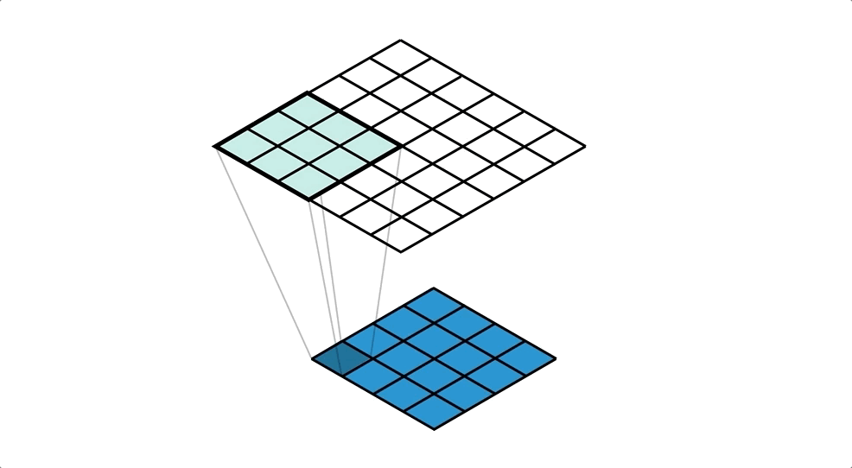
Convolution versus transpose convolution
Down-sample
Up-sample
Credit: V. Dumoulin & F. Visin
Credit: T. Lane
Multiple input pixels map to one output pixel
Each layer increases number of kernels to build more complex features
Stride 2 (sliding the convolution filter 2 pixels) down-samples to reduce computational overhead
Each input pixel maps to multiple output pixels
Effective stride 1/2 up-samples to return to original image size
Higher-resolution activations from down-sampling layer can then be added to the up-sampled images

Slide 10
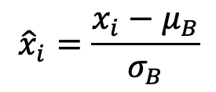
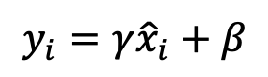
Normalisation and activation function
Why normalise?
Input data changes with each batch/epoch, so input distribution can vary and these variations build up deep in the network
Small/large gradients can vanish/explode as they are multiplied in deep networks
Batch normalisation ensures each batch has zero mean and unit variance, giving consistent input distributions and avoiding gradient problems, but also scales and shifts to avoid loss of representational power
Why ReLU?
Non-linear activations have high representational power
It’s fast. Simple gradient calculation (0 or 1)
Doesn’t squash activations with repeated activation (unlike sigmoid)
Batch normalisation
$${\hat{x}}_{i}=\frac{x_{i}−μ_{B}}{σ_{B}}$$
$$y_{i}={γ\hat{x}}_{i}+β$$
Rectified Linear Unit

Slide 11
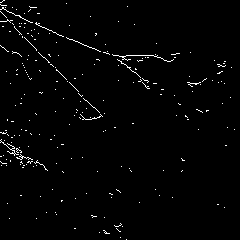
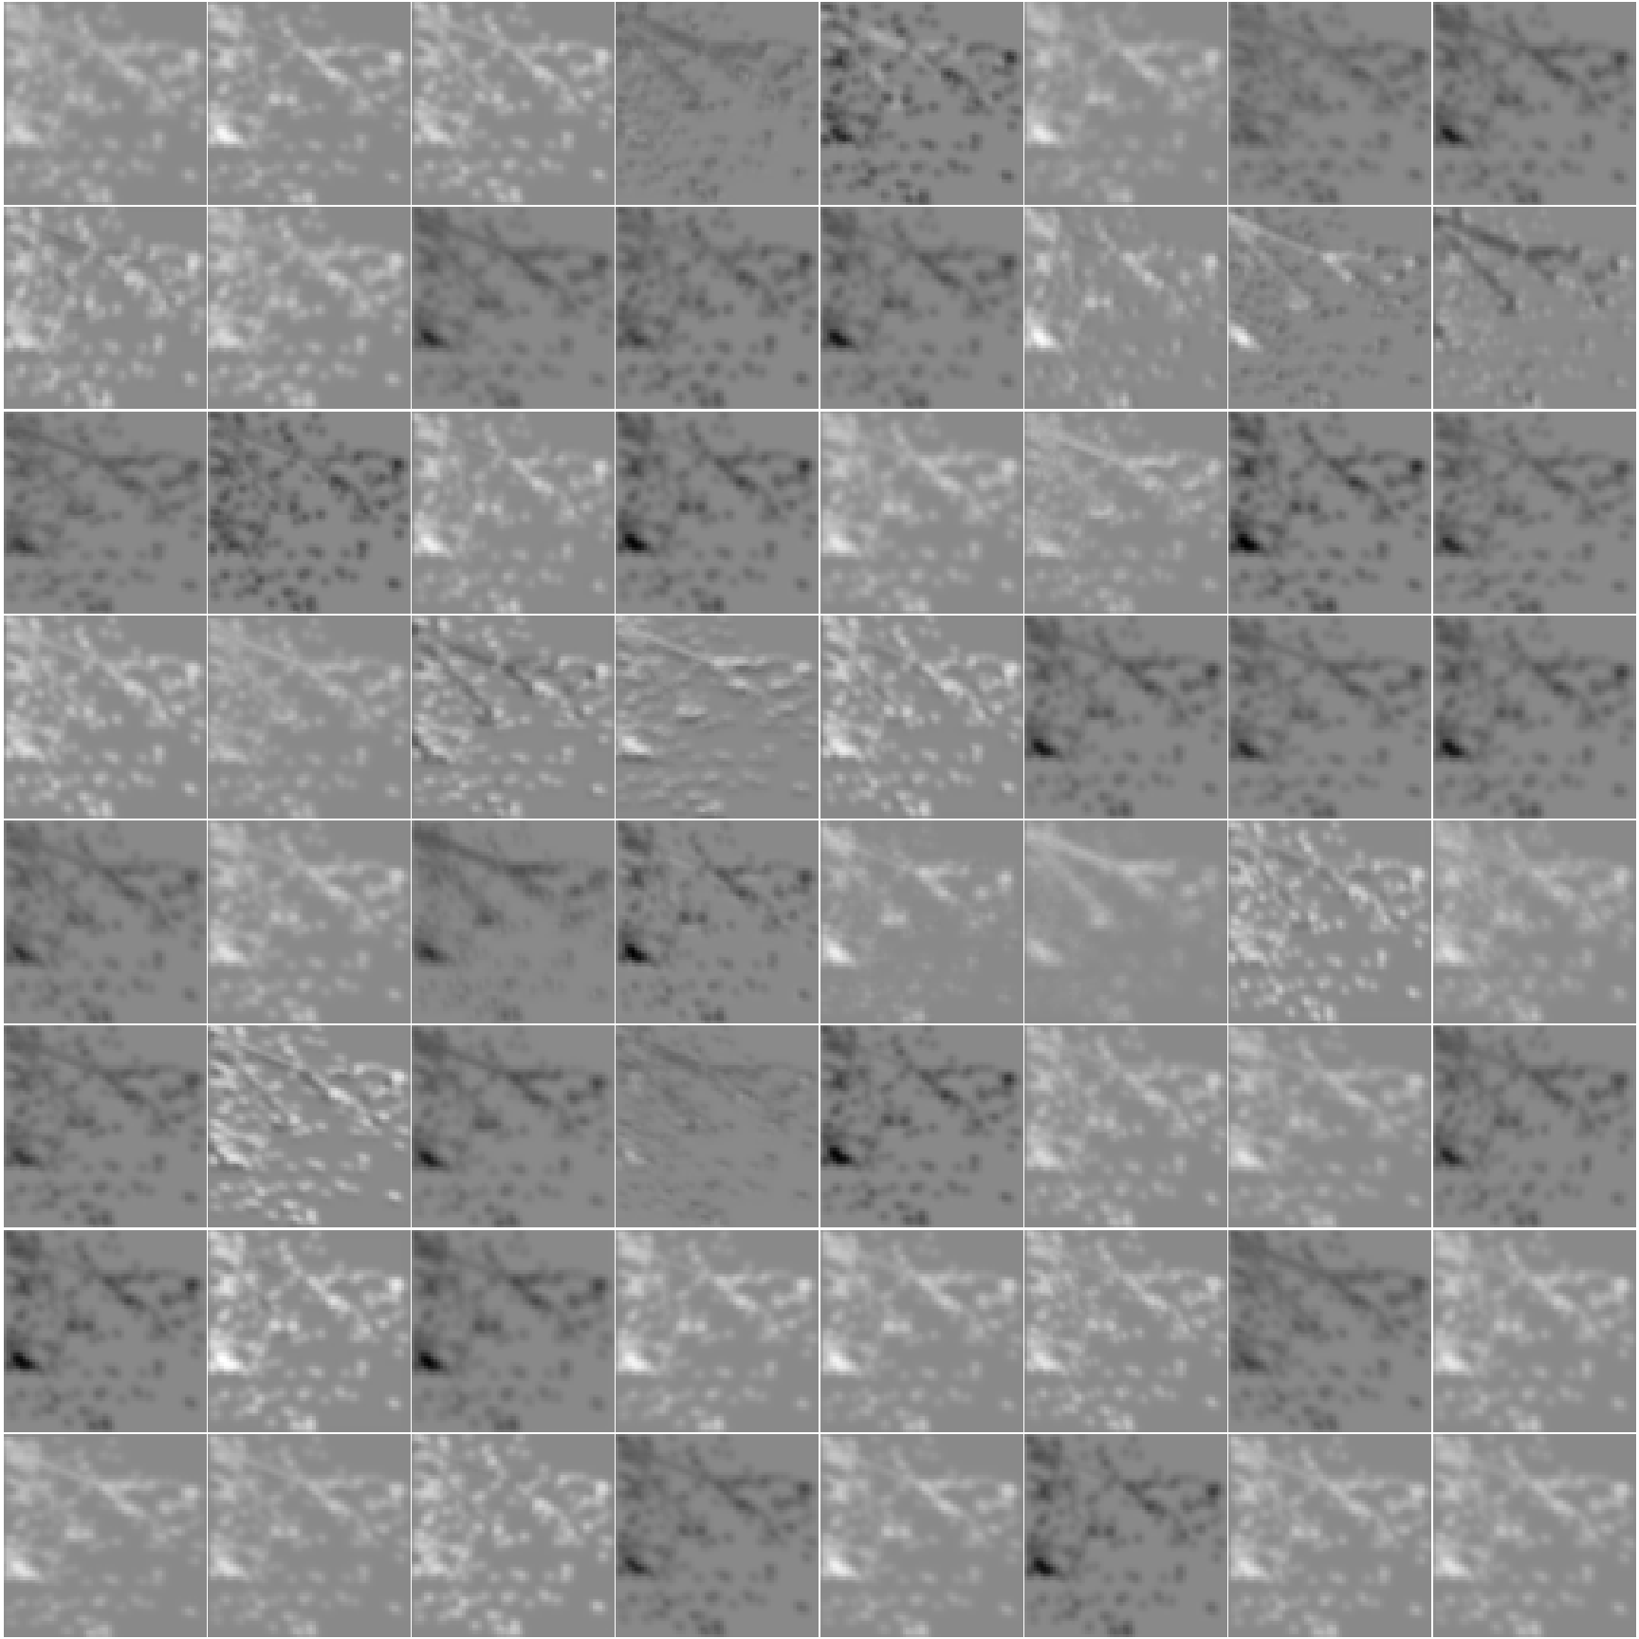
Intermediate activations
Determining what the network is doing can be extremely challenging
Ultimately however, it is just a set of activations in different layers that variously accentuate or attenuate features of the inputs
Here we have a set of activations for randomly selected filters at different depths of the U-Net
DS Layer 1
US Layer 4
DS Layer 3
US Layer 2
Bridge

Slide 12
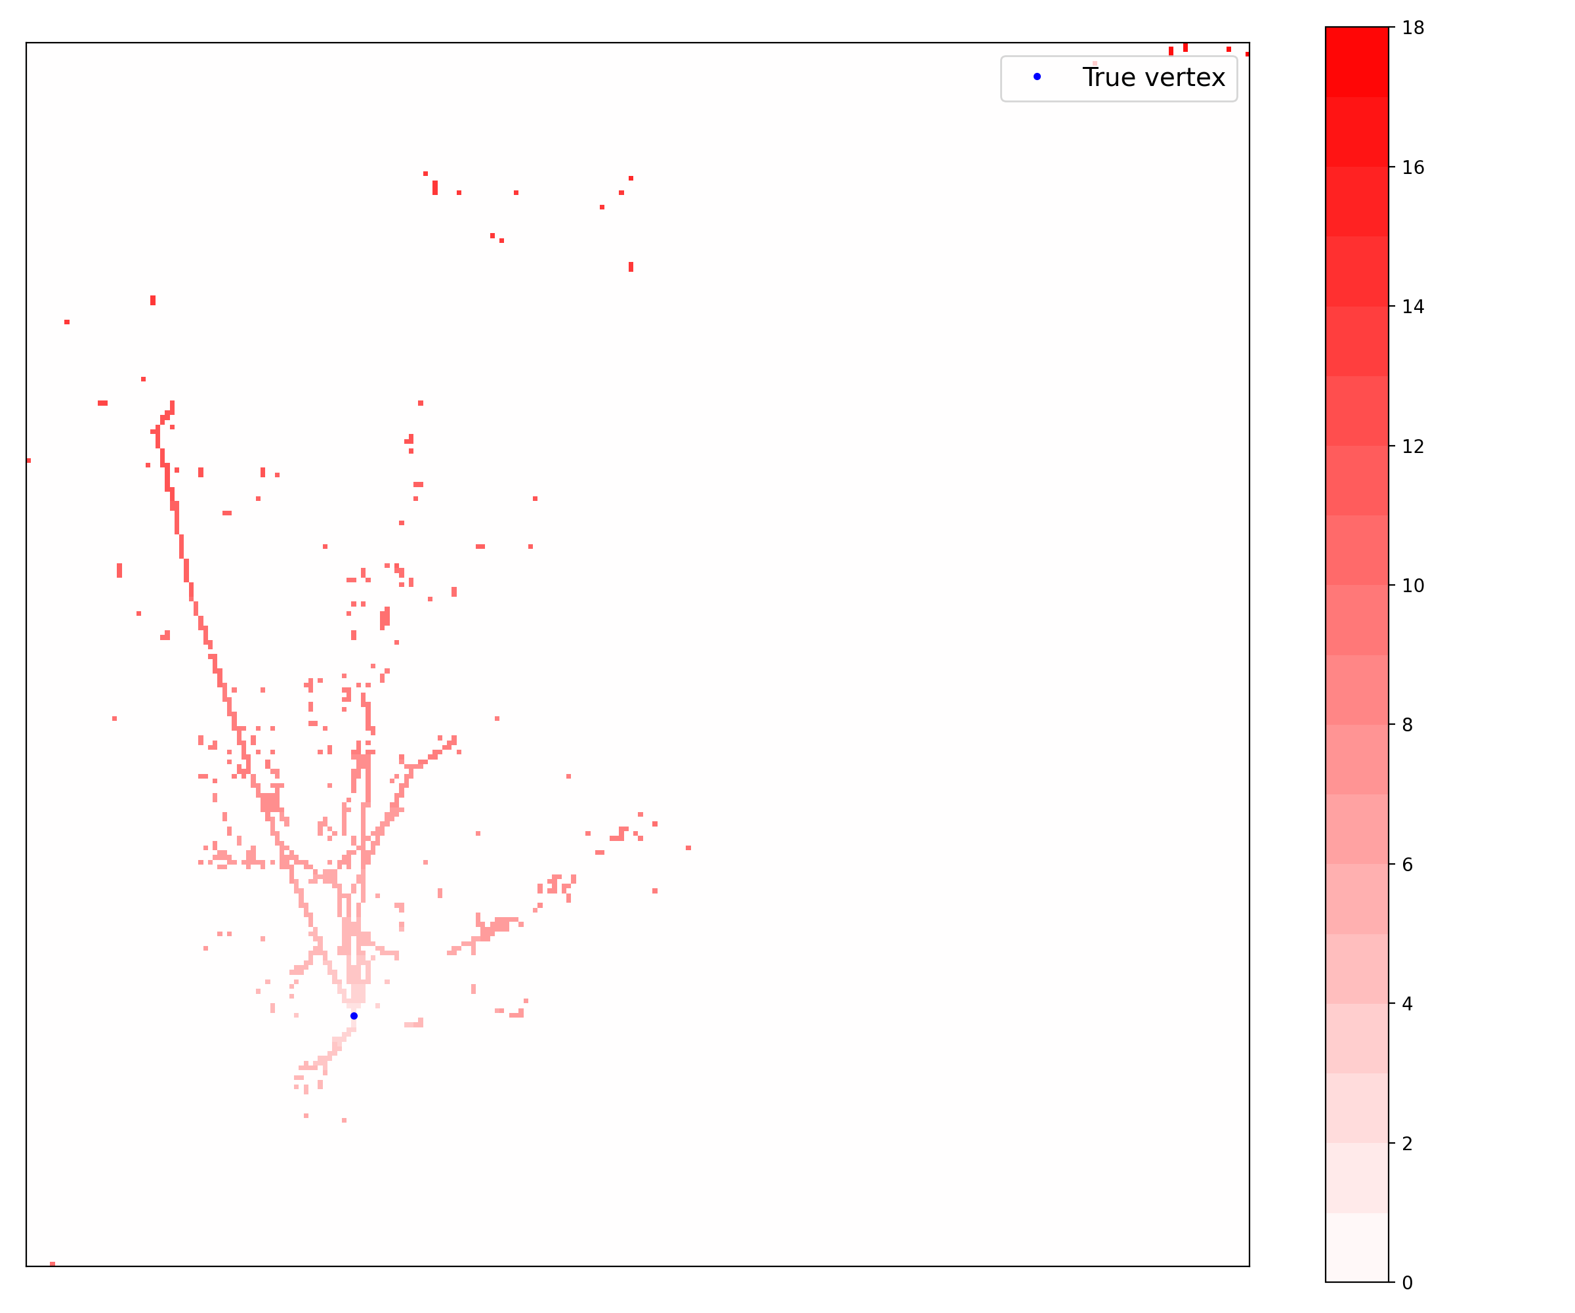
Using semantic segmentation in Pandora
Semantic segmentation forms the basis of Pandora’s vertex finding algorithm for DUNE
Why would you use a classification network to find an interaction vertex?
Regression for vertex finding in LArTPCs is hard
You ask a network to learn a single (or small set of) target location(s) in a complex image
Semantic segmentation treats the whole image as a target to learn
Classify each pixel according to its distance from the estimated vertex location
Adjacent pixels are obviously correlated, so context helps learning
The network doesn’t return a vertex location
How do we extract the vertex?
Network classification

Slide 13
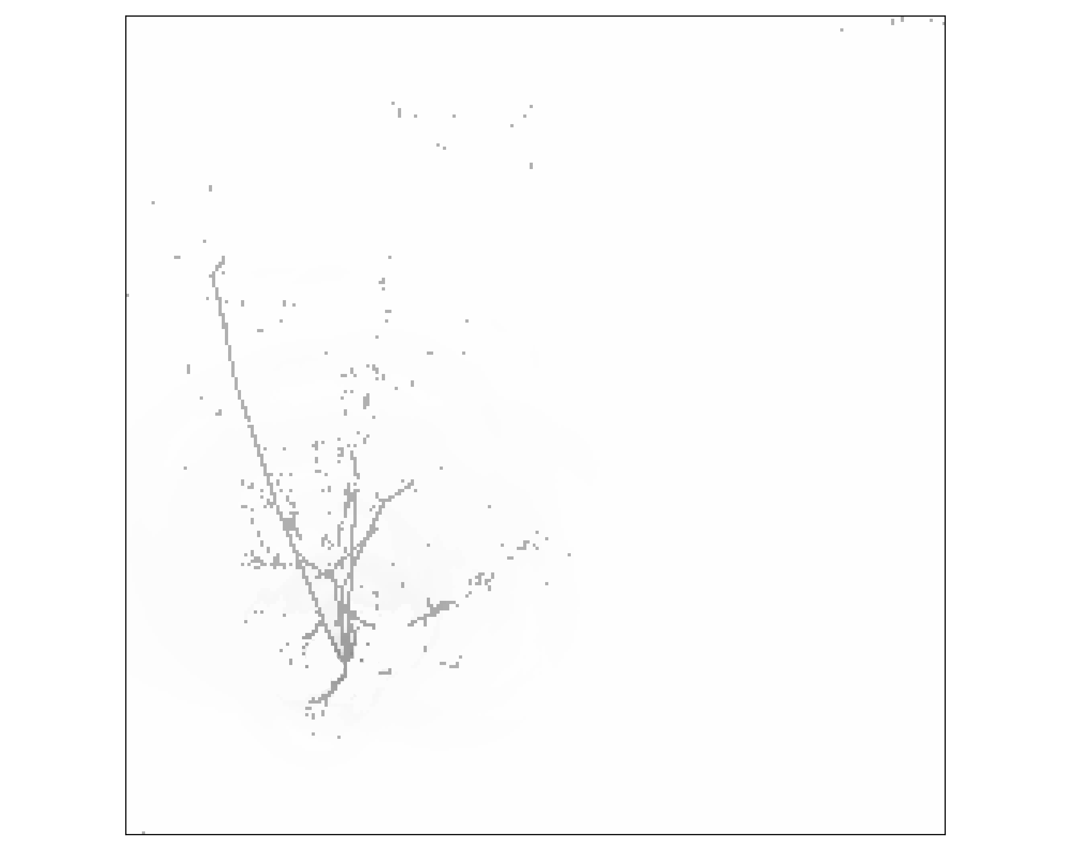
Mixing deep learning with ‘traditional’ algorithms
We have a set of distance classes for each occupied pixel
For each hit, convert the class to the known lower and upper distance bounds
Draw a ring, centred on the hit with radii corresponding to those distance bounds
Weight the pixels in the ring inversely proportional to its area
Vertex could be anywhere within the shaded region of one ring
Many rings for a heat map, where high weight indicates likely location
Image from a single wire plane
Heat map from one classified pixel

Slide 14
Mixing deep learning with ‘traditional’ algorithms
We have a set of distance classes for each occupied pixel
For each hit, convert the class to the known lower and upper distance bounds
Draw a ring, centred on the hit with radii corresponding to those distance bounds
Weight the pixels in the ring inversely proportional to its area
Vertex could be anywhere within the shaded region of one ring
Many rings for a heat map, where high weight indicates likely location
Heat map from one classified pixel
Heat map from two classified pixels

Slide 15
Mixing deep learning with ‘traditional’ algorithms
We have a set of distance classes for each occupied pixel
For each hit, convert the class to the known lower and upper distance bounds
Draw a ring, centred on the hit with radii corresponding to those distance bounds
Weight the pixels in the ring inversely proportional to its area
Vertex could be anywhere within the shaded region of one ring
Many rings for a heat map, where high weight indicates likely location
Heat map from two classified pixels
Heat map from three classified pixels

Slide 16
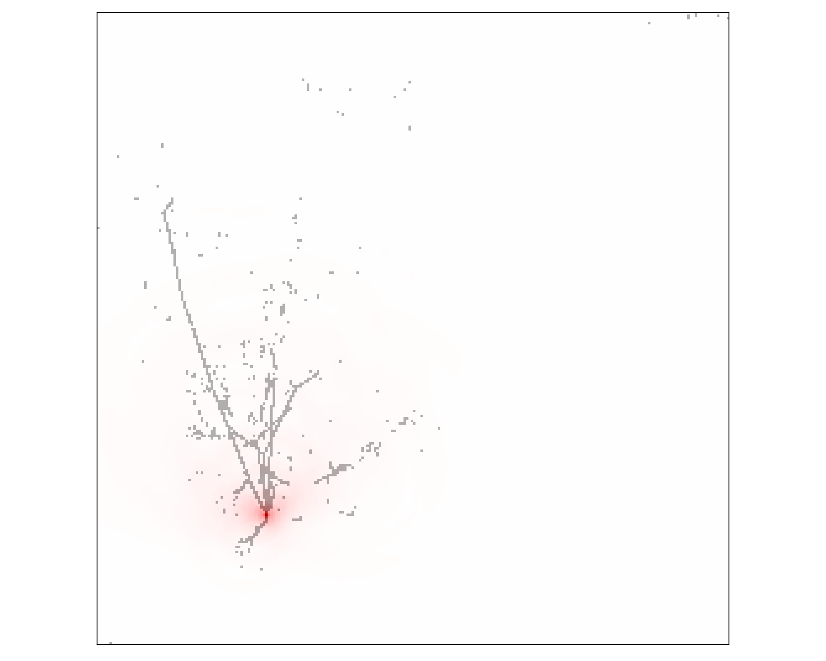
Mixing deep learning with ‘traditional’ algorithms
We have a set of distance classes for each occupied pixel
For each hit, convert the class to the known lower and upper distance bounds
Draw a ring, centred on the hit with radii corresponding to those distance bounds
Weight the pixels in the ring inversely proportional to its area
Vertex could be anywhere within the shaded region of one ring
Many rings for a heat map, where high weight indicates likely location
Heat map from 3 classified pixels
Heat map from all classified pixels

Slide 17
A brief aside on TorchScript
Currently, LArSoft expects PyTorch networks to be C++-based and CPU-bound for inference
This will hopefully change in time, but until it does, if you have a deep neural network you’d like to use in, Pandora, for example, you need to know about TorchScript
Pandora’s vertex finding network was trained using Python on GPUs, but you can’t run that in Pandora, you need to convert it
device = torch.device('cpu')
model = load_model(filename, device) # custom code to load your specific model
sm = torch.jit.script(model)
sm.save(output_filename)
TorchScript can take a model defined using standard PyTorch code and convert it to a format that can be run on a CPU
Such a network can now be used in Pandora (you’ll need to manage the inputs and outputs of course, but we won’t cover that today)

Slide 18
ResNet
We’ll now return to take a brief look at probably the most famous CNN for classification, ResNet
Like semantic segmentation, ResNet was introduced in 2015
There are a lot of neat ideas introduced in this paper, but the key one is the introduction of the residual (the Res in ResNet) shortcut connection
This innovation allowed networks to get much deeper and still train effectively
Instead of learning the mapping from input to output, you learn the residuals that get you from input to output
e.g, if the optimal mapping is the identity, it’s easier to push the residuals to zero than to relearn the identity
Input
Input
Instead of this
Conv
Conv
ReLU
ReLU
This
Conv
Conv
ReLU
ReLU

Slide 19
Getting some practical experience
Having briefly introduced the ResNet, it’s now time to use one to classify some neutrino interactions…

